Slide 1
Disk-Scheduling Algorithm
What is disk scheduling algorithms in OS?
'Disk Scheduling Algorithm' is an algorithm that keeps and manages input and output requests arriving for the disk in a system. As we know, for executing any process memory is required.

Slide 2
Disk scheduling algorithms are techniques used by operating systems to determine the order in which disk I/O requests are processed by the disk's read/write heads.
These algorithms aim to optimize disk access by reducing seek time(No. of movement by r/w head) and maximizing throughput.

Slide 3
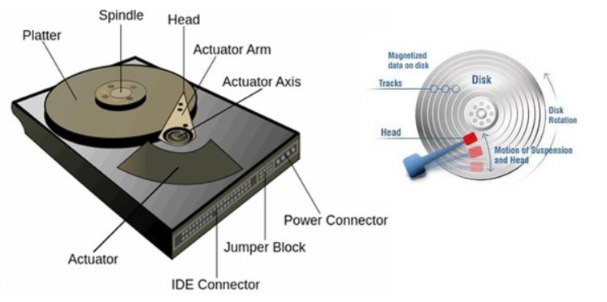
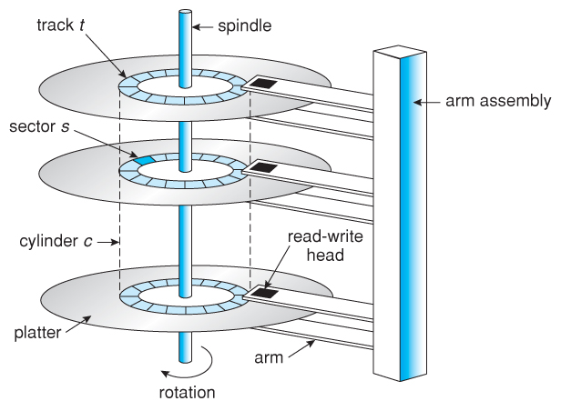

Slide 4
FCFS
FCFS (First-Come, First-Served) disk scheduling algorithm serves disk I/O requests in the order they arrive. It may lead to increased access time and higher seek time(No. of movement by r/w head) as there's no specific prioritization. Therefore, this algorithm is straightforward to implement but may not be optimal(best) in scenarios where prioritization is important.

Slide 5
Questions: 98,183,41,122,14,124,65,67 read/write head current position -53 cylinders are number from 0-199. Total head movement = ?
0
14
41
53
65
67
98
122
124
183
190
199

Slide 6
Advantage of fcfs:
Total head movement:
=(98-53)+(183-98)+(183-41)+(122-41)+(122-14)+(124-14)+(124-65)+
(67-65)
=632.
Easy to implement
It may suffer from convey effect.
Work better with less load.
Disadvantage of fcfs:
It is inefficient.
Increased total seek time

Slide 7
SSTF
SSTF is the name of an algorithm that comes under Disk Scheduling. SSTF stands for “Shortest Seek Time First” disk scheduling algorithm. In SSTF, the I/O request for which the disk arm requires the least movement is served first. The movement is independent of the direction. In other words, instead of following a particular direction, it goes for the request that is closest to its current position.

Slide 8
Questions: 98,183,41,122,14,124,65,67 read/write head current position -53 moving towards large cylenders no. Total 200 cylinders. Total head movement = ?
0
14
41
53
65
67
98
122
124
183
190
199
Total Head movement=
(65-53)+(67-65)+(67-41)+(41-14)+(98-14)+(122-98)+(124-122)+(183-124)
=236.

Slide 9
Advantage of sstf:
Reduced total seek time as compared to fcfs.
It provides increased throughput.
It provides less average response time and waiting time.
Disadvantage of sstf:
Overhead in finding out the closest request.
It provides high variance in response time and waiting time.
Switching the direction of head frequently slows down the algorithms.

Slide 10
SCAN
The SCAN algorithm moves the disk arm from one end of the disk to the other, servicing requests as it travels.
It services all requests in one direction until it reaches the end of the disk, then it reverses direction and services requests in the opposite direction.

Slide 11
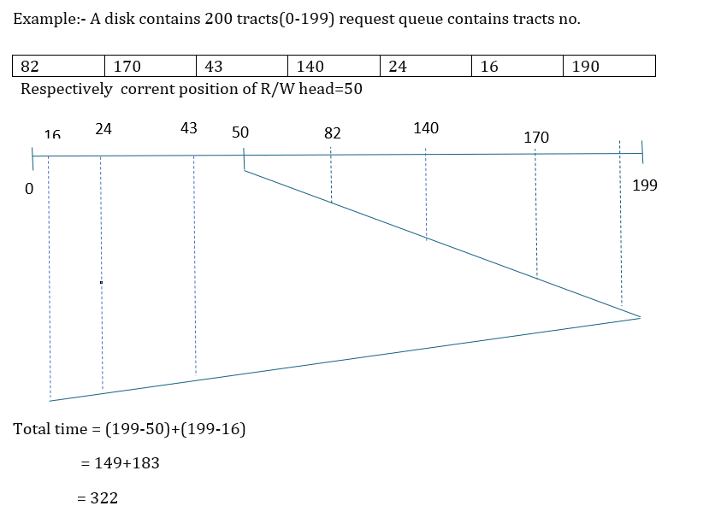

Slide 12
C-SCAN
C-SCAN is a variant of the SCAN algorithm, which addresses some of its limitations.
In C-SCAN, the disk arm only scans in one direction (e.g., from 0 to the maximum cylinder number), but when it reaches the end, it immediately returns to the beginning without servicing any requests.
This means that the head only moves in one direction, which simplifies the implementation.

Slide 13
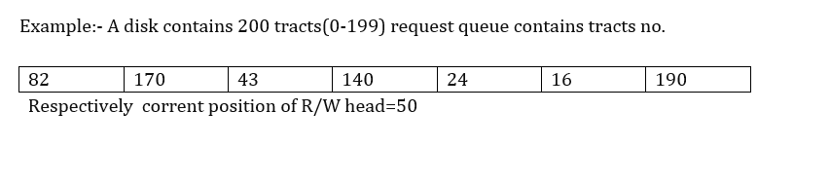
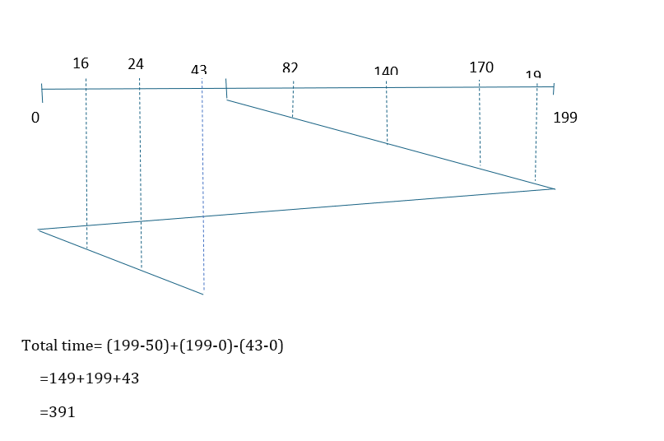

Slide 14
LOOK
LOOK Disk Scheduling Algorithm is the advanced version of the SCAN disk scheduling algorithm. In this algorithm, the disk arm moves in a particular direction till the last request is found in that direction and serves all of them found in the path, and then reverses its direction and serves the requests found in the path again up to the last request found. The only difference between SCAN and LOOK is, it doesn't go to the end it only moves up to which the request is found.

Slide 15
EXAMPLE
Let's take an example to understand the LOOK Disk Scheduling Algorithm. Let's take a disk with 180 tracks (0-179) and the disk queue having input/output requests in the following order: 75, 90, 40, 135, 50, 170, 65, 10. The initial head position of the Read/Write head is 45 and would move on the right-hand side. Find the total number of track movements of the Read/Write head using the LOOK disk scheduling algorithm.

Slide 16
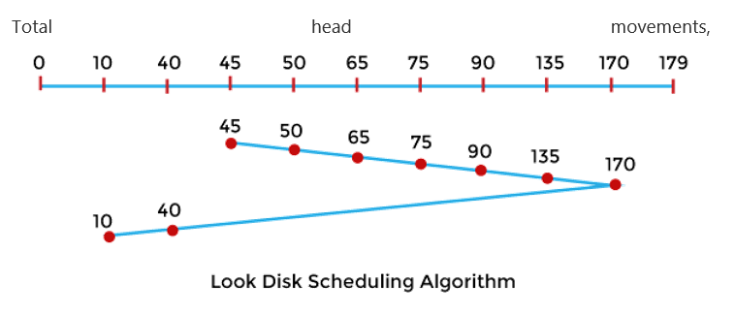
The initial head point is 45,
= (50-45) + (65-50) + (75-65) + (90-75) + (135-90) + (170-135) + (170-40) + (40-10)
= 5 + 15 + 10 + 15 + 45 + 35 + 130 + 30
= 285

Slide 17
Advantage of look:
It provides better performance in comparison to the SCAN algorithm.
The LOOK scheduling algorithm avoids starvation.
The head will not move to the end of the disk if no more requests are fulfilled.
Waiting time and response time have a low variance.
Disadvantage of look:
There is an overhead of finding the final requests.
Should not be used in the case of more Load.

Slide 18
C-look
C-LOOK Disk Scheduling Algorithm is an enhanced version of both SCAN as well as LOOK disk scheduling algorithms. C-LOOK Stands for circular-LOOK. C-LOOK algorithm is an improved version of the LOOK algorithm.
Example:
Let's take an example to understand the C-LOOK Disk Scheduling Algorithm. Let's take a disk with 180 tracks (0-179) and the disk queue having input/output requests in the following order: 75, 90, 40, 135, 50, 170, 65, 10. The initial head position of the Read/Write head is 45 and would move on the right-hand side. Find the total number of track movements of the Read/Write head using the C-LOOK disk scheduling algorithm

Slide 19
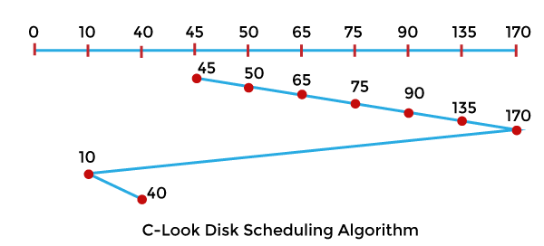
Total head movements,
The initial head point is 45,
= (50-45) + (65-50) + (75-65) + (90-75) + (135-90) + (170-135) + (170-10) + (40-10)
= 5 + 15 + 10 + 15 + 45 + 35 + 160 + 30
= 315

Slide 20
Advantage of c-look:
It provides better performance compared to the LOOK disk scheduling algorithm.
If no requests are to be served, the head doesn't have to go all the way to the end of the disk in the C-LOOK disk scheduling algorithm.
In C-LOOK, there is minimal waiting time for cylinders that are only visited by the head.
Waiting time and response time have a low variance.
Disadvantage of c-look:
The overhead of finding the end requests is present in C-LOOK.

